Slide 1
Credit Score Classification
Presented By: Mohammad Amil Khan

Slide 2
PROBLEM STATEMENT
Develop a robust machine learning model to accurately predict credit scores based on various financial and personal attributes. This model will automate the assessment of creditworthiness, enabling more efficient and data-driven decision-making in credit-related processes.

Slide 3
OBJECTIVE
In this project, we explore a multiclass classification problem using a dataset containing diverse financial and personal attributes related to individuals’ credit profiles. The objective is to build robust predictive models to accurately classify individuals into credit score categories such as Poor, Fair, Good, and Excellent. By leveraging machine learning algorithms like Random Forest, XGBoost, and Logistic Regression, we aim to enhance the accuracy, efficiency, and consistency of creditworthiness assessment, ultimately supporting smarter and faster financial decision-making.

Slide 4
WORK FLOW
Step 1 | Import Libraries
Importing Required Libraries
Step 2 | Read Dataset
Gathering and organizing data to train machine learning models.
Step 3 | Dataset Overview
Basic and Descriptive Data Overview
Step 4 | EDA
Analyzing and visualizing data patterns to understand its characteristics
Step 5 | Data Preprocessing
Preparing and cleaning data to enhance its quality and suitability
Step 6 | Split Train And Test Data
Dividing the dataset into training and testing sets to evaluate
Step 7 | Model Training
Choosing a suitable machine learning algorithm and optimizing its parameters
Step 8 | Model Evaluation
Assessing the performance of a machine learning model using metrics
Step 9 | Conclusion
Conclusion of Models and EDA
Step 10 | Power BI Dashboard
Power BI Dashboard and it’s Conclusion

Slide 5
DATA COLLECTION & REFINEMENT
Variable | Description
ID | Unique identifier for each record
Customer_ID | Unique ID for each customer
Month | The month of the record
Name | Full name of the customer
Age | Age of the customer
SSN | Social Security Number (personal identifier)
Occupation | Type of job/occupation of the customer
Annual_Income | Total income earned in a year
Monthly_Inhand_Salary | Net monthly income after deductions
Num_Bank_Accounts | Number of bank accounts held
Num_Credit_Card | Number of credit cards held
Interest_Rate | Interest rate applicable on the credit
Num_of_Loan | Total number of loans taken
Type_of_Loan | Types of loans taken (e.g., Home, Auto, Personal)
Delay_from_due_date | Days delayed in payment from due date
Num_of_Delayed_Payment | Total number of delayed payments
Changed_Credit_Limit | Amount by which the credit limit was changed
Num_Credit_Inquiries | Number of times credit history was checked (e.g., for loans/cards)
Credit_Mix | Mix of different types of credit (Good/Standard/Bad)
Outstanding_Debt | Unpaid or pending debt amount
Credit_Utilization_Ratio | Ratio of used credit limit to total credit limit
Credit_History_Age | Age of the credit history in years/months
Payment_of_Min_Amount | Whether the minimum payment was made (Yes/No)
Total_EMI_per_month | Sum of EMIs to be paid monthly
Amount_invested_monthly | Amount invested each month
Payment_Behaviour | Behavioral pattern of payment (e.g., regular, irregular)
Monthly_Balance | Remaining balance at the end of the month
Credit_Score | Credit score of the customer (e.g., Good, Standard, Poor)
ROWS=100000
Columns=28
Target Variable = Credit Score
0 → Poor
1 → Standard
2 → Good

Slide 6
EXPLORATORY DATA ANALYSIS
Exploratory Data Analysis (EDA) helped us understand the data structure, find patterns, identify trends, and gain valuable insights from the dataset.
From EDA we analyze, the distribution of each features, checking the correlation between the features .
The datasets is not clean, as there is NULL values and some OUTLIERS.
We need to clean the data for our machine learning.

Slide 7
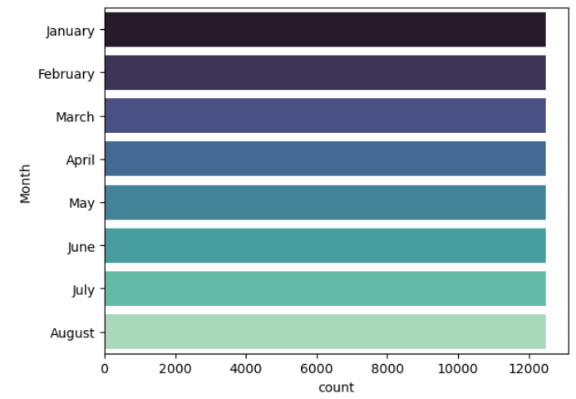
Monthly Distribution of Customer Records
The number of customers is evenly distributed across months, with August having the highest count and January the lowest.

Slide 8
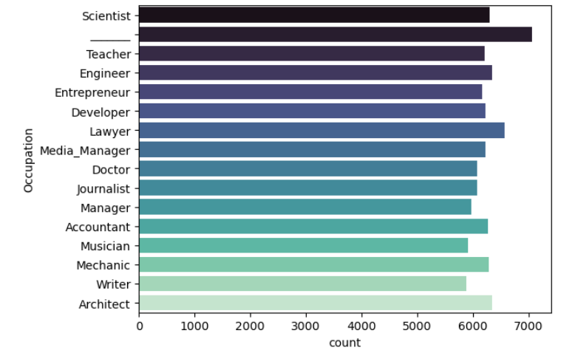
Distribution of Customers by Occupation
Lawyer is the most common occupation in the dataset, slightly surpassing Scientist, indicating a strong legal presence in the sample. There is also one missing value that we will remove or fill it.

Slide 9
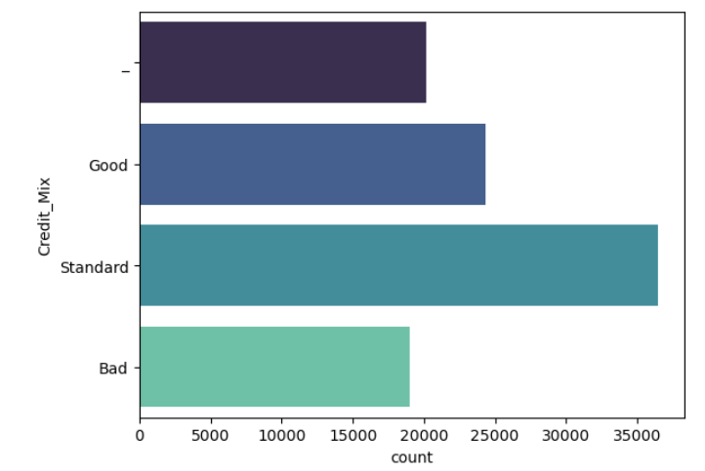
Distribution of Credit Mix Categories
"Standard" is the most common Credit Mix category, followed by "Good," while "Bad" and missing values are the least represented

Slide 10
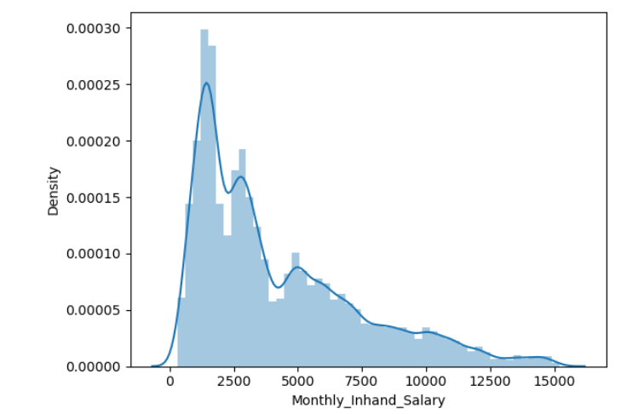
Distribution of Monthly In hand Salary
Most individuals earn between 1,000 and 4,000 monthly, with salary distribution skewed toward lower income ranges.

Slide 11
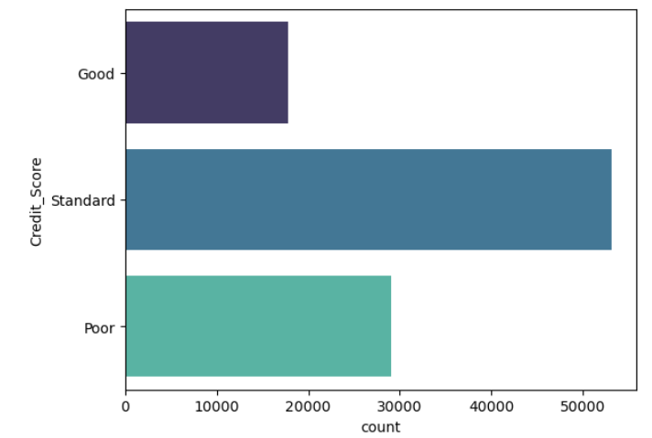
Distribution of Credit Scores among Individuals
The majority of individuals have a Standard credit score, followed by Poor, while Good credit scores are the least common in the dataset.

Slide 12
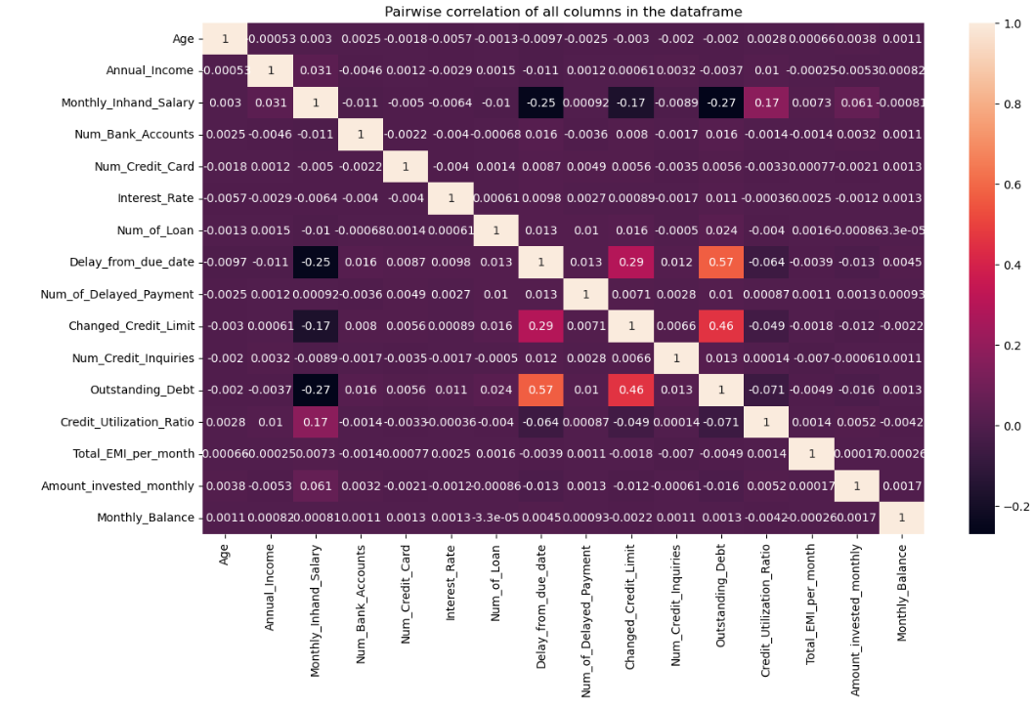
Heatmap of Pairwise Correlation Between Numerical Features
The strongest positive correlation is between Outstanding_Debt and Delay_from_due_date (0.57), suggesting that higher debt is associated with more payment delays.

Slide 13
PREPROCESSING
Irrelevant Feature Removal: 'ID', 'Name', 'SSN’, ’Customer_ID’
Duplicates Value: No duplicates found.
Missing Value Treatment: Missing values found in dataset and filled.
Outliers Treatment: Checked outliers using Outlier Detection method for the continuous features and upon identifying outliers all outliers are removed.
Categorical Feature Encoding: Applied label encoding.
Feature Scaling: Power transform done after train and test split on numerical columns.

Slide 14
SPLITING THE DATA INTO X & Y
We divided the dataset into two parts: X and y.
"X" typically represents the independent Variables, and "y" represents the Dependent (target variable) that we want to predict or understand.
Random Over sampling is used
We use Random over sampling to oversample because the dataset is imbalanced.
TRAIN TEST SPLIT
We divided the data into training (80%) and testing (20%) sets.

Slide 15

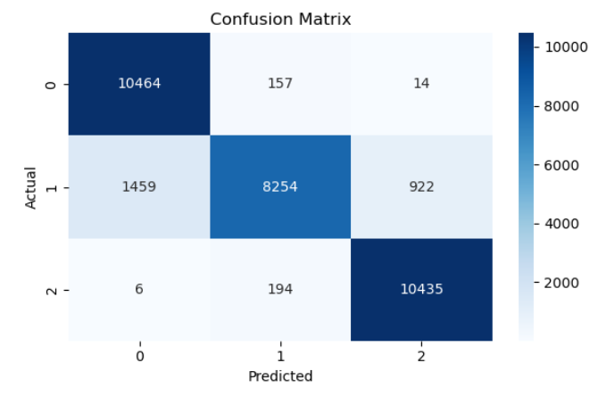
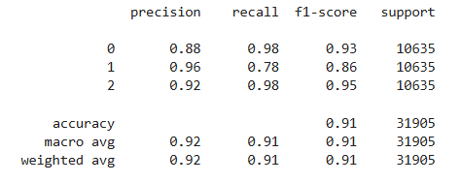
Random Forest Report

Slide 16
MODEL COMPARISON
MODEL | Accuracy | Precision | Recall | F1-Score
Logistic Regression | 69 | 72 | 70 | 71
XGBoost | 88 | 88 | 96 | 92
Random Forest Classifier | 91 | 92 | 98 | 95

Slide 17
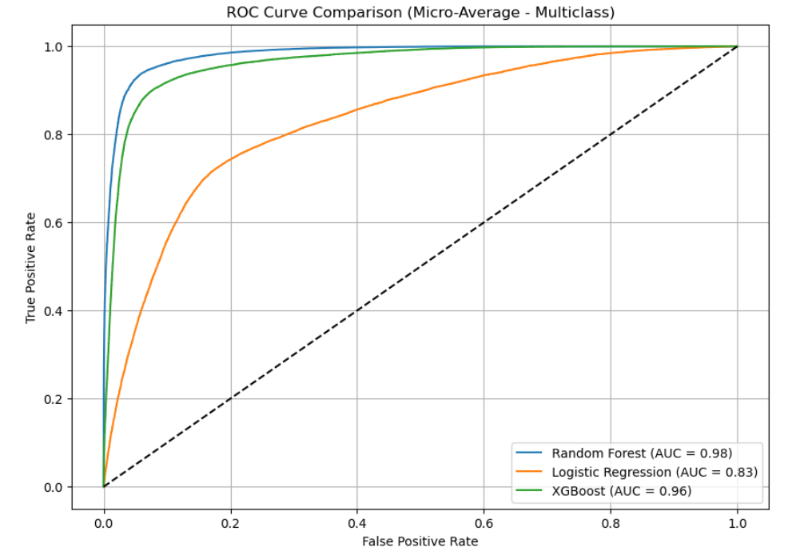
AUC-ROC CURVE FOR ALL MODELS
Random Forest stands out with the highest AUC of 0.98, showcasing exceptional classification accuracy and the ability to clearly distinguish between classes.
XGBoost follows closely with an AUC of 0.96, indicating strong predictive power and reliable performance across categories.
Logistic Regression lags behind with an AUC of 0.83, suggesting decent but comparatively lower discriminative capability than the ensemble-based models.
Conclusion: Random Forest outperforms both XGBoost and Logistic Regression in multiclass classification based on ROC-AUC.

Slide 18
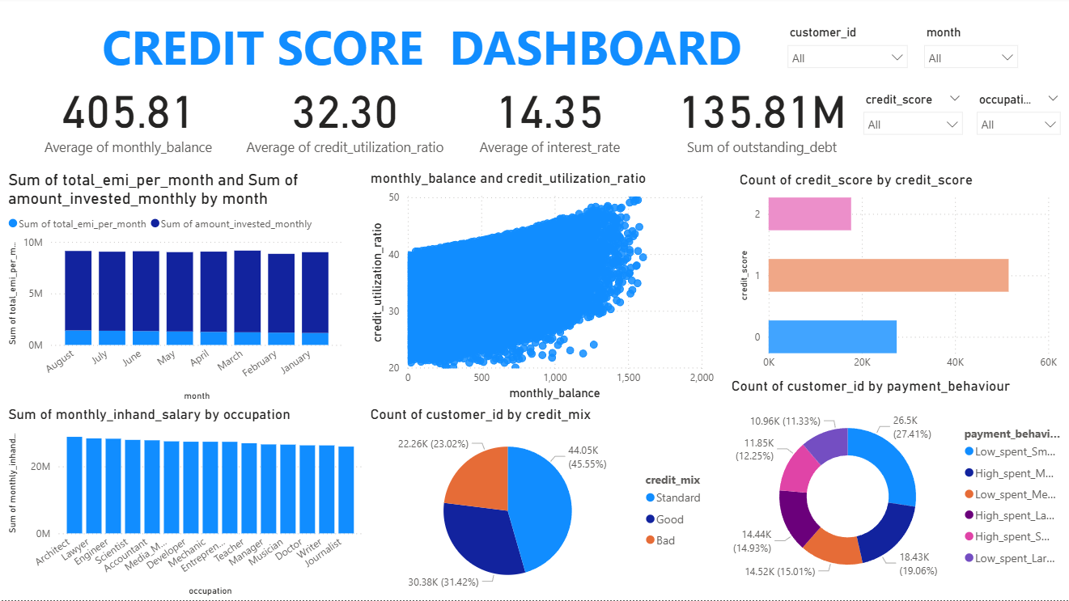

Slide 19
INSIGHTS
Overall Financial Metrics
Avg. Monthly Balance: ₹405.81 – moderate liquidity
Avg. Credit Utilization Ratio: 32.30% – healthy credit usage
Avg. Interest Rate: 14.35% – relatively high borrowing cost
Outstanding Debt: ₹135.81M – significant credit exposure
Spending & Investment Patterns
Consistent EMI Payments: Monthly EMIs remain stable around ₹9–10M
Investments: Amount invested monthly is consistently lower than EMIs – suggests higher debt servicing than savings
Trends by Occupation
Top Earners: Architects, Lawyers, Engineers, and Doctors show highest monthly in-hand salary
Uniform Distribution: Salary spread appears balanced across occupations
Credit Score Distribution
Majority users fall into mid-tier credit score range (between 0 and 2)
Very few users have extremely poor or high scores – balanced credit health
Utilization vs Balance Correlation
Positive Trend Observed: As monthly balance increases, credit utilization ratio also rises
Suggests high earners tend to leverage more credit
Payment Behavior Insights
Top Category: Low spent – Large value payments (27.41%)
Other High Categories:
Low spent – Medium value (19.06%)
High spent – Small value (15.01%)
Spending Skews: Lean toward low frequency but large payments, indicating controlled spending behavior
Credit Behavior Breakdown
Credit Mix:
Standard: 45.55% , Good: 31.42%, Bad: 23.02%
Indicates a majority of users have standard to good credit variety

Slide 20
Conclusion
The credit score dashboard reveals a financially stable user base with moderate credit utilization and regular EMI payments. Salaries are fairly distributed across professions, and while most users maintain standard credit mixes, there’s room for improvement in diversifying credit profiles. Payment behavior shows a tendency toward larger, less frequent spending, which may be contributing to the controlled utilization ratios. Overall, the financial ecosystem is healthy but can benefit from promoting investments and enhancing credit diversity.

Slide 21
Thank You!

